Slide 1
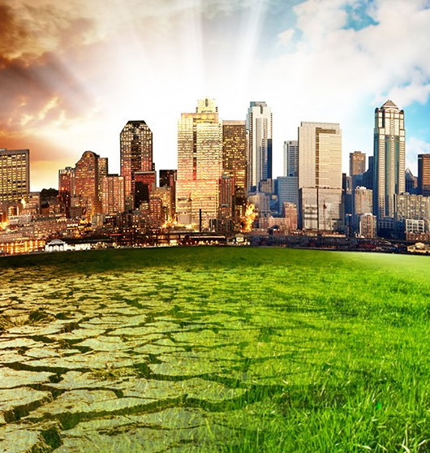
Decarbonization – Shipping and Oil & Gas Industry
Hardik Malhotra
Email id – hardikmalhotra19@gmail.com
Contact No. – 8979258810
LinkedIn- linkedin.com/in/hardik-malhotra-205aa0149/

Slide 2
Report Content
Shipping / Oil & Gas
Sl. No.
Report Content
Page No.
1
EXECUTIVE SUMMARY
3
2
TRENDS AND INITIATIVES (SHIPPING)
5
3
CHALLENGES & MANDATING REGULATIONS (SHIPPING)
6
4
TRENDS AND INITIATIVES (OIL & GAS)
8
5
CHALLENGES & MANDATING REGULATIONS (OIL & GAS)
9

Slide 3




Executive Summary
Shipping / Oil & Gas
Shipping
Oil & Gas
Trends
Adoption of Alternative Fuels
Joint Initiatives
Policy and Regulations
Digitization and New Technologies
Disclosing Consistent, Comparable and Reliable Data
Cheaper Renewables technologies
Policy and Regulations
Ramping Capacity at Ports
Policy frameworks
Deployment of Electric and Hybrid Vessels
Investment in Alternative Fuel Technologies
Improved Maintenance Routines
Tapping into Natural Carbon Sinks
Changing power sources
Reducing fugitive emissions
Electrifying equipment
Initiatives
Challenges
High Capital Costs
Lack of Infrastructure
Technological Readiness and Scale
Lack of Granular Data
Lack of Clear Regulation to Set Standards
Transitioning to renewable energy sources
Regulations
International Maritime Organization (IMO) Regulations
European Union (EU) Regulations
National Regulations
Emissions reduction targets
Carbon pricing mechanisms
Methane regulations

Slide 4
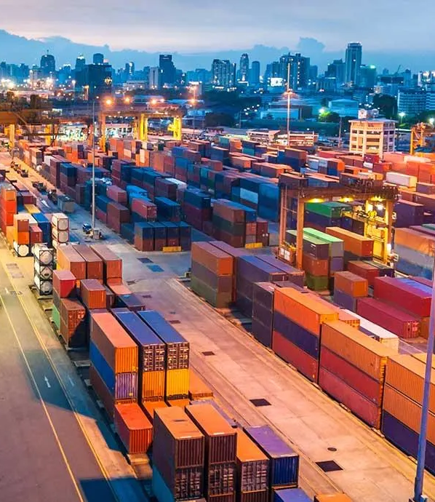
Shipping Industry

Slide 5

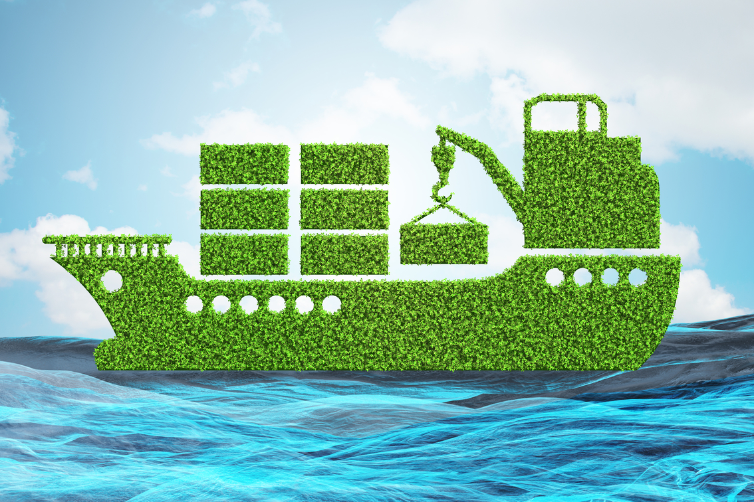
Trends and Initiatives
Shipping
Adoption of Alternative Fuels
Engaging energy providers to explore solutions and scale up the production of low and zero carbon fuels.
Joint Initiatives
Decarbonization goes beyond fuels and technologies, and can only be achieved in partnership with others like Maritime Just Transition Task Force, and many more
Trends
Policy and Regulations
There is an increasing focus on policy and regulations to drive decarbonization in the shipping industry.
Digitization and New Technologies
Improvement in fleet’s efficiency using digital tools and new technologies .
Ramping Capacity at Ports
Building further throughput capacity at ports – may lead to increased system efficiency
Policy frameworks
Establishing policy frameworks to incentivize decarbonized shipping and the production of low- and zero-carbon marine fuels
Deployment of Electric and Hybrid Vessels
Shipping companies are also investing in electric and hybrid vessels as part of their decarbonization strategies.
Initiatives
Investment in Alternative Fuel Technologies
Investing in green ammonia, green methanol , solar powered batteries and hydrogen fuel cells for the transport.
Adopting Alternative Fuels is the best practice adopted by the players operating in the shipping industry. It is considered as one of the most significant steps towards decarbonization in the shipping industry using fuels such as liquefied natural gas (LNG), biofuels, hydrogen, and ammonia, which produce lower, or zero carbon emissions compared to traditional fossil fuels like diesel and heavy fuel oil.

Slide 6



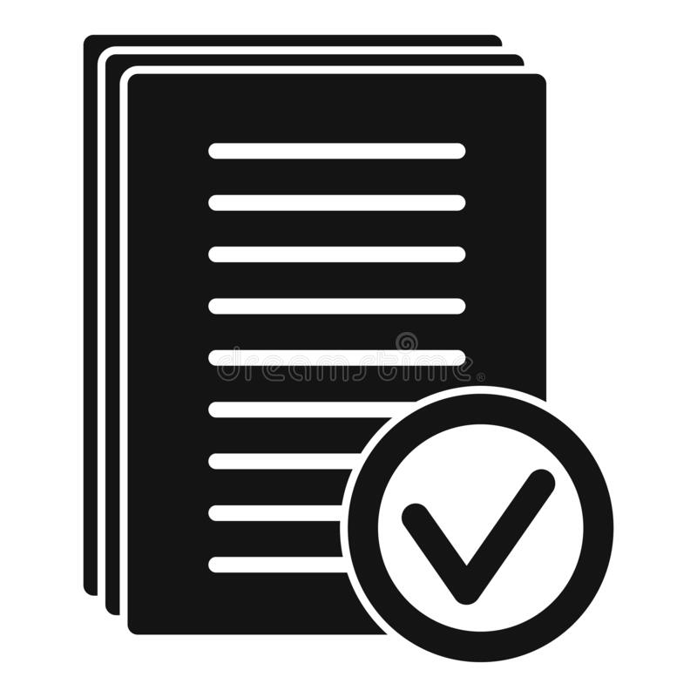
Challenges & Mandating Regulations
Shipping
High Capital Costs
Transitioning to alternative fuels, adopting new technologies, and optimizing ship designs can involve significant upfront capital costs.
Lack of Infrastructure
The availability of infrastructure for alternative fuels, such as LNG, hydrogen, and ammonia, is limited, especially in certain regions.
Technological Readiness and Scale
Some of the alternative fuels and technologies being explored for decarbonization, such as hydrogen and ammonia, are still in the early stages of development and not yet widely available or proven at a large scale in the maritime industry.
International Maritime Organization (IMO) Regulations
The IMO, a United Nations agency responsible for regulating international shipping, has set ambitious decarbonization targets for the industry. The IMO's Initial Strategy on Reduction of GHG Emissions from Ships aims to reduce the total annual GHG emissions from international shipping by at least 50% by 2050 compared to 2008 levels, and to pursue efforts to phase out GHG emissions entirely.
European Union (EU) Regulations
The EU has also introduced regulations that mandate decarbonization requirements in the shipping industry. The EU's Monitoring, Reporting, and Verification (MRV) Regulation requires ships exceeding 5,000 gross tonnage to monitor and report their CO2 emissions, fuel consumption, and other relevant data on an annual basis.
National Regulations
Several countries and regions around the world have also introduced or are considering introducing national regulations to mandate decarbonization requirements in the shipping industry. For example, Norway has implemented a carbon tax on cruise ships and ferries based on their CO2 emissions, and is also offering incentives for the adoption of low- and zero-emission technologies.

Slide 7
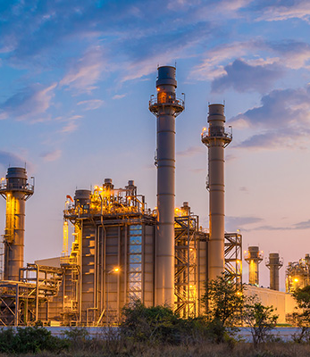
Oil & Gas Industry

Slide 8
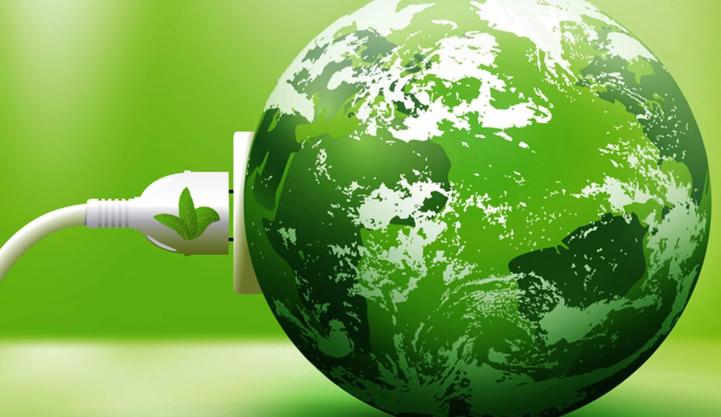
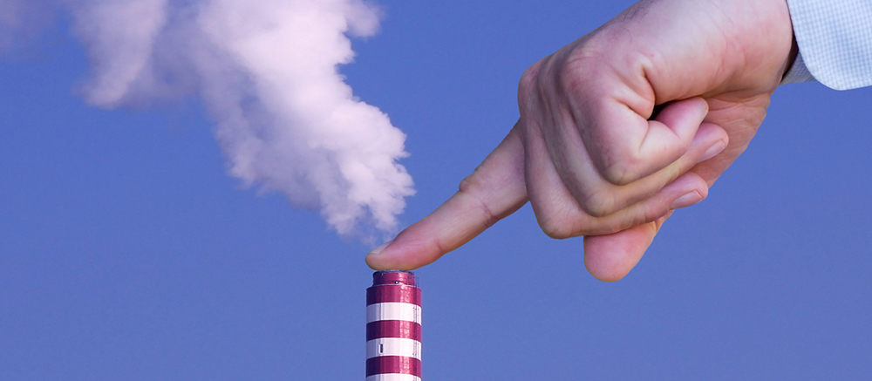
Trends and Initiatives
Oil & Gas
Disclosing Consistent, Comparable and Reliable Data
Investors are pushing companies to disclose consistent, comparable, and reliable data, for instance, shareholders are challenging US- and Europe-based oil majors on their climate policies and emissions-reduction plans.
Renewables technologies getting cheaper
Since 2011, the price of solar energy—both photovoltaic (PV) and utility scale—has decreased by more than 70% in the US, and the price of wind has decreased by about two-thirds. They might be competitive in many more regions by 2025 with natural gas-based power generation.
Trends
Policy and Regulations
There is an increasing focus on policy and regulations to drive decarbonization in the Oil & gas industry.
Improved Maintenance Routines
Improved maintenance routines to reduce intermittent flaring and vapor-recovery units to reduce methane leaks.
Tapping into Natural Carbon Sinks
By utilizing the earth's natural carbon sinks, such as the oceans, vegetation, soil, and forests, we can reduce the amount of greenhouse gases (GHGs) in the air and remove them from the atmosphere. For example, the Italian energy giant ENI has announced plans to plant 20 million acres (four times Wales' size) of forest in Africa to act as a carbon sink.
Changing power sources
Oil and gas company is using on-site renewable-power generation to provide a cost-effective alternative to diesel fuel.
Initiatives
Reducing fugitive emissions
By enhancing leak detection and repair (LDAR), adding vapor-recovery units (VRU), or utilising the finest technologies available, businesses are reducing methane emissions, a potent GHG.
Electrifying equipment
One company replaced gas boilers with electric steam-production systems, including high-pressure storage for nighttime steam supply, to support separation units.
Changing Power Sources is the best practice adopted by the players operating in the Oil & Gas industry. By replacing generators with a solar PV and battery setup, the company not only reduced emissions significantly but also broke even on its investment in five years.

Slide 9
Challenges & Mandating Regulations
Oil & Gas
Lack of Granular Data
Methane has an outsize impact on the near-term warming trajectory due to its short atmospheric lifetime and high heat absorption. The concentration of methane in the atmosphere today is 2.4 times higher than preindustrial levels, but emissions are not monitored or regulated at the local or global level.
Lack of Clear Regulation to Set Standards
Lack of clear regulation to set standards for reporting and mitigation. Several large players have pledged to monitor, report, and reduce their methane emissions, and buyers increasingly see emissions intensity transparency as important.
Transitioning to renewable energy sources
The oil and gas industry has traditionally been built around the extraction and production of fossil fuels. Transitioning to renewable energy sources, such as solar, wind, and bioenergy, presents challenges in terms of technological and infrastructural changes, as well as investment and financing
Emissions reduction targets
Many countries and regions have established emissions reduction targets, such as the Paris Agreement's goal to limit global warming to well below 2 degrees Celsius and pursue efforts to limit the temperature increase to 1.5 degrees Celsius.
Carbon pricing mechanisms
Carbon pricing mechanisms, such as carbon taxes and emissions trading systems (ETS), put a price on carbon emissions, providing an economic incentive for oil and gas companies to reduce their emissions. Carbon pricing can encourage companies to invest in cleaner technologies and practices and can also generate revenue that can be used to support decarbonization efforts.
Methane regulations
Methane is a potent greenhouse gas emitted during oil and gas production, and regulations targeting methane emissions are becoming more common. These regulations may include requirements for methane monitoring, reporting, and reduction measures, such as leak detection and repair programs and equipment upgrades.

Slide 10
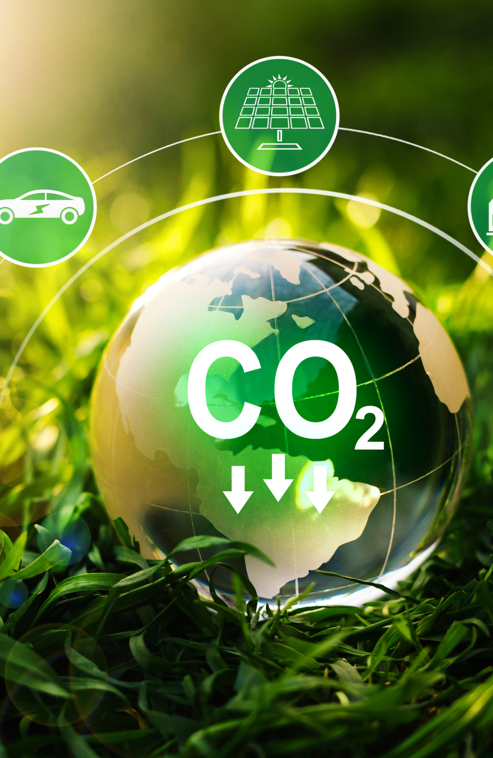
Thank You
References-
https://www.msc.com/
https://www2.deloitte.com/content/dam/Deloitte/us/Documents/energy-resources/us-eri-oil-and-gas-decarbonization.pdf
https://www.mckinsey.com/industries/oil-and-gas/our-insights/the-future-is-now-how-oil-and-gas-companies-can-decarbonize
https://corporate.exxonmobil.com/news/reporting-and-publications/advancing-climate-solutions-progress-report
https://www.chevron.com/-/media/shared-media/documents/chevron-sustainability-report-2021.pdf
https://www.maersk.com/sustainability/reports-and-resources

